Slide 1
Product Sales Analysis
Dashboard

Slide 2
INTRODUCTION
Understanding sales and profits is essential for business growth. Companies track total sales for each product and monitor units sold across different cities. They analyze sales by region and record key details like sales figures, units sold, price per unit, and average retailer sales. To measure performance, they calculate average sales per product and determine operating profit. Yearly sales and profits are reviewed, while sales and profit trends are monitored by state and region. Businesses also observe monthly sales and profit patterns to identify trends and opportunities. By evaluating operating profit across regions, companies can make informed decisions to improve profitability.

Slide 3
OBJECTIVE
Total sales are calculated for each product.
Units sold are tracked by city.
Sales totals are analyzed by region.
Sales, units sold, price per unit, and average retailer sales are recorded.
Average sales are measured for each product.
Operating profit is calculated by product.
Yearly product sales and profits are analyzed.
Sales and profit are tracked by state.
Monthly sales and profit trends are observed.
Operating profit is evaluated by region.

Slide 4
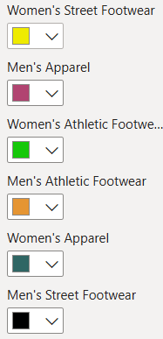
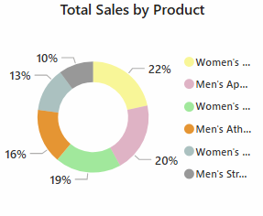
1. Total Sales by Product (Donut Chart)
Displays the percentage of different product categories in total sales.
Each color represents a different category, with product sales percentage labeled (e.G., 22%, 20%, 19%, etc.).
The product groups are highlighted: Men's Apparel, Men's Athletic Footwear, Men's Street Footwear, Women's Apparel, Women's Athletic Footwear, Women's Street Footwear.
The highest sales percentage is 22% (Women's Street Footwear).
It also changes based on product, year, month, and state.

Slide 5
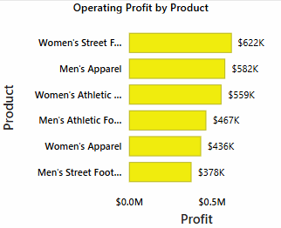
2. Operating Profit by Product (Bar Chart)
Women's Street Footwear has the highest profit of $622K.
Men's Apparel comes next with $582K profit.
Women's Athletic Footwear follows with $559K profit.
Men's Athletic Footwear earns $467K profit.
Women's Apparel has $436K profit.
Men's Street Footwear has the lowest profit at $378K.
It also changes based on product, year, month, and state.

Slide 6
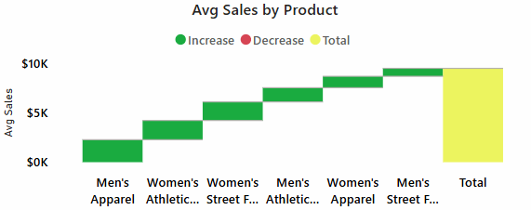
3. AVERAGE Sales by Product (Waterfall Chart)
The Y-axis represents the average sales in dollars, ranging from $0K to $10K.
The X-axis represents different product categories:
Men's Apparel
Women's Athletic Footwear
Women's Street Footwear
Men's Athletic Footwear
Women's Apparel
Men's Street Footwear
The green bars show an increase in sales for each product.
The red color (if present) would indicate a decrease in sales (not visible here).
The yellow bar represents the total average sales for all products combined.
Sales gradually increase as more products are added, leading to the total at the end.
It also changes based on product, year, month, and state.

Slide 7
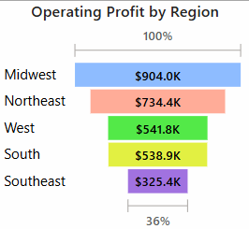
4.OPERATING PROFIT BY REGION (FUNNEL)
Regions and Profits:
Midwest: $904.0K (Highest)
Northeast: $734.4K
West: $541.8K
South: $538.9K
Southeast: $325.4K (Lowest)
Percentage Scale:
Midwest is at 100% (highest).
Southeast is at 36% (lowest).
Bar Lengths: Longer bars indicate higher profits, shorter bars indicate lower profits.

Slide 8
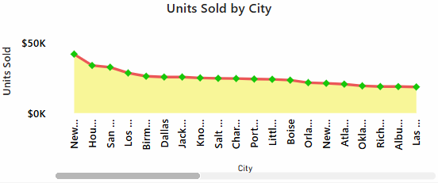
5.UNITS SOLD BY CITY (LINE CHART)
Y-Axis (Vertical): Represents the number of units sold (ranging from $0K to $50K).
X-Axis (Horizontal): Represents different cities (city names are shortened).
Trend:
The highest number of units sold is in the first city (New York).
The last few cities have the lowest sales.
Visualization Details:
A yellow shaded area represents the sales trend.
A red line connects the data points.
Green diamond markers indicate individual data points.
Scrollable X-Axis: More cities can be viewed by scrolling.

Slide 9
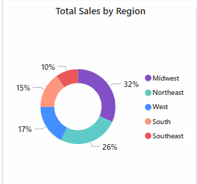
6.TOTAL SALES BY REGION (DONUT CHART )
Regions and Sales Percentages:
Midwest (Purple) – 32% (Highest)
Northeast (Teal) – 26%
West (Blue) – 17%
South (Orange) – 15%
Southeast (Red) – 10% (Lowest)
Legend: Colors represent different regions.
Distribution: The Midwest has the largest sales (32%) share, while the Southeast has the smallest (10%).

Slide 10
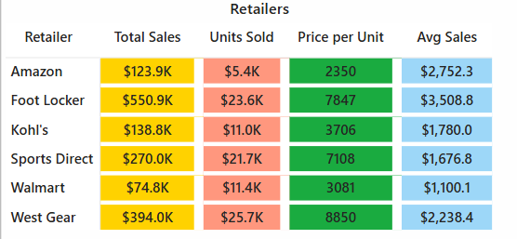
7.Retailers (Table showing sales data for different retailers)
Columns:
Retailer – Name of the retailer (e.g., Amazon, Foot Locker, Walmart, etc.)
Total Sales – Total revenue in dollars (highlighted in yellow)
Units Sold – Number of units sold (highlighted in red)
Price per Unit – Price per unit of the product (highlighted in green)
Avg Sales – Average sales per unit (highlighted in blue)
Observations:
Foot Locker has the highest Total Sales ($550.9K).
West Gear sold the most Units Sold (25.7K).
West Gear also has the highest Price per Unit (8850).
Foot Locker has the highest Avg Sales ($3,508.8).
Walmart has the lowest Avg Sales ($1,100.1).
Color Coding: Different colors are used for each category to make the data visually clear.

Slide 11
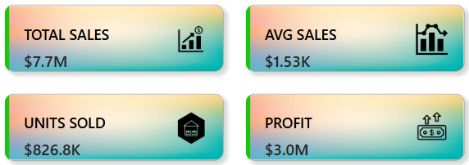
8.Dashboard-style summary of key sales metrics.
Overall Interpretation:
The business has generated $7.7M in total sales.
Profit of $3.0M suggests a strong financial performance.
A high number of 826.8K units sold indicates strong demand.
The average sales per unit is $1.53K, showing the typical revenue per sale.

Slide 12
THANK YOU

